Slide 1
Visualization of Trees (& Graphs)
with some help from Miriah Meyer (SCI, USA)

Slide 2
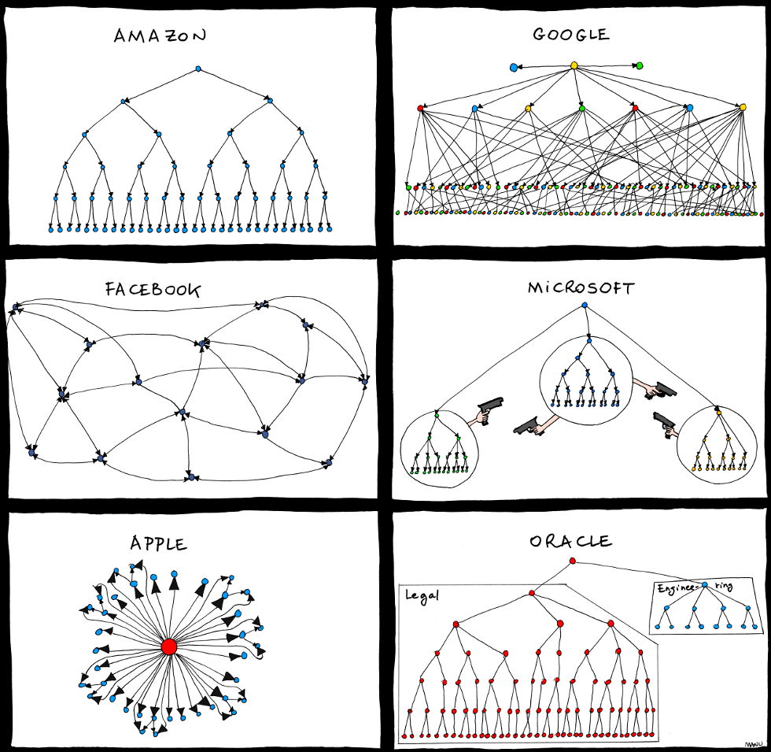
Graphs & Trees: Some Examples
http://www.bonkersworld.net/organizational-charts/

Slide 3
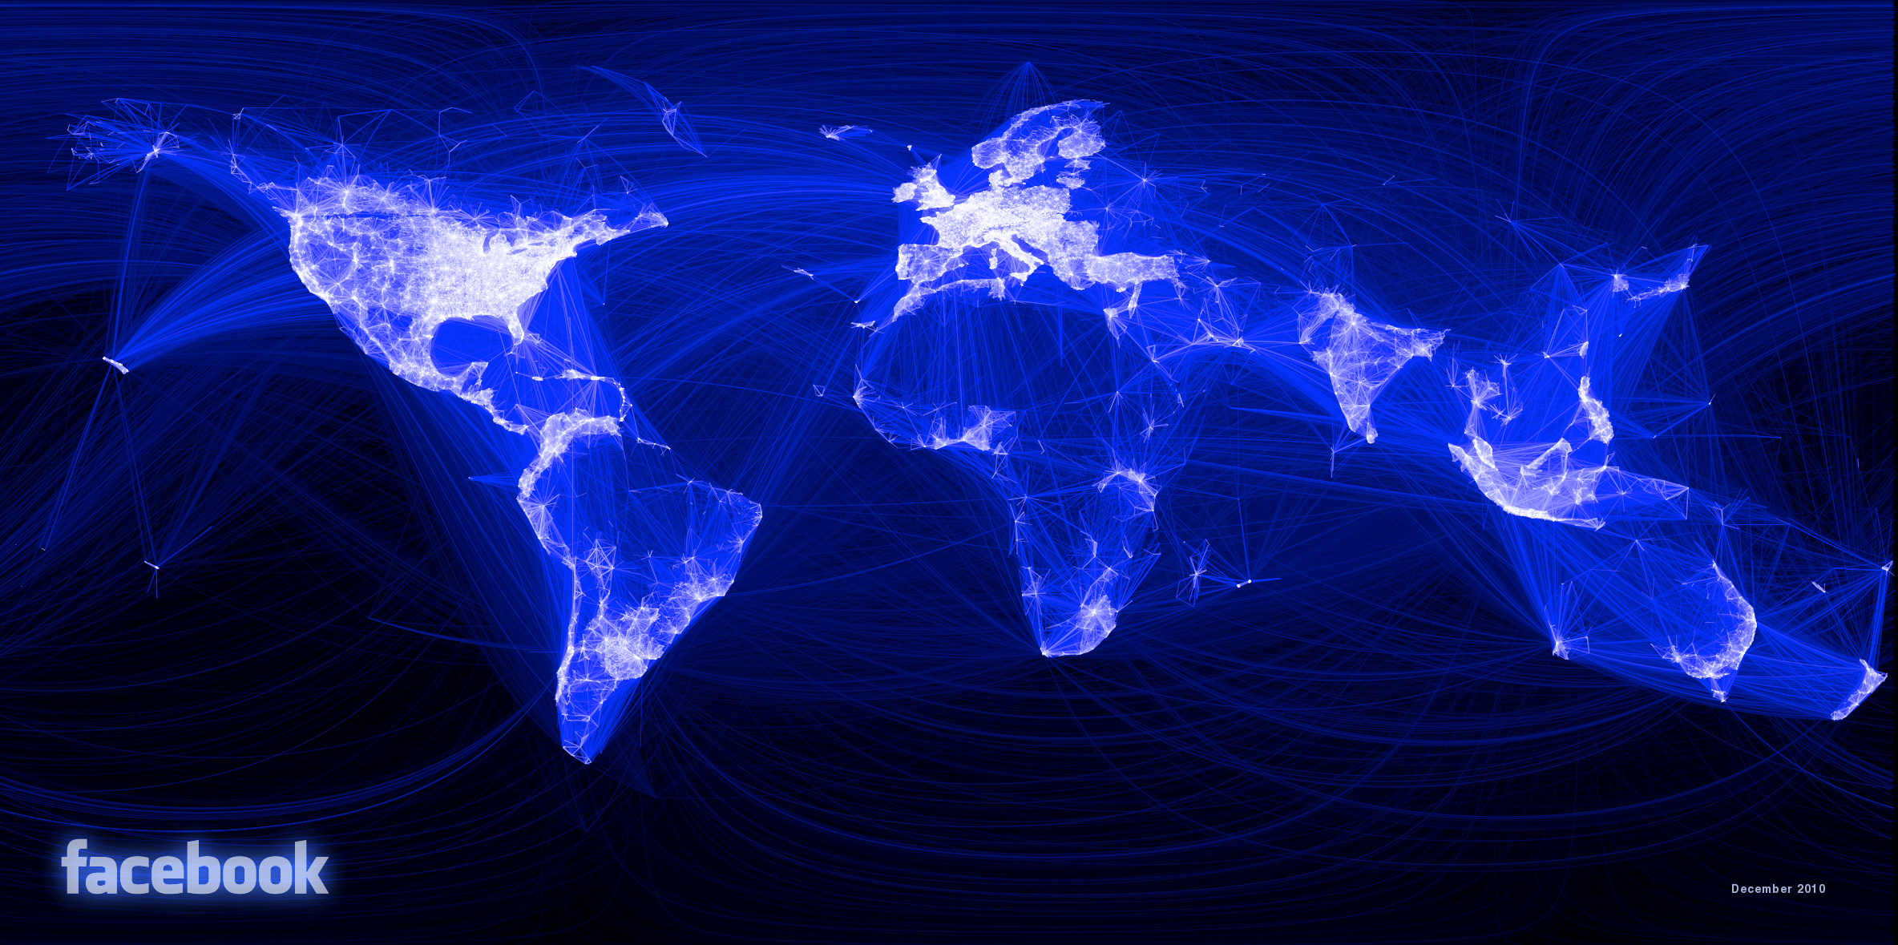

Slide 4
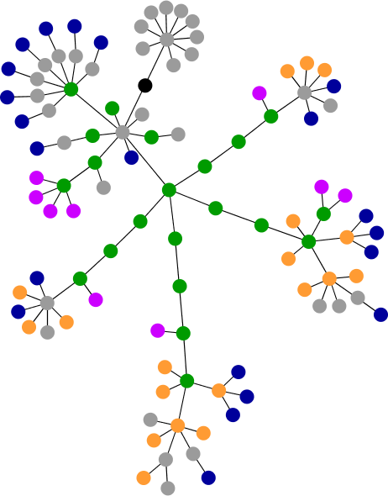
Graphs & Trees: Some Examples
Webpages as trees
DOM-Tree visualized
Physics-based, force-directed layout
Try it yourself:
http://www.aharef.info/
blue: for links (the A tag) red: for tables (TABLE, TR and TD tags) green: for the DIV tag violet: for images (the IMG tag) yellow: for forms (FORM, INPUT, TEXTAREA, SELECT and OPTION tags) orange: for linebreaks and blockquotes (BR, P, and BLOCKQUOTE tags) black: the HTML tag, the root node gray: all other tags
tinoweinkauf.net

Slide 5
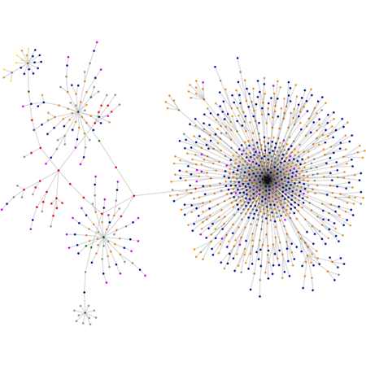
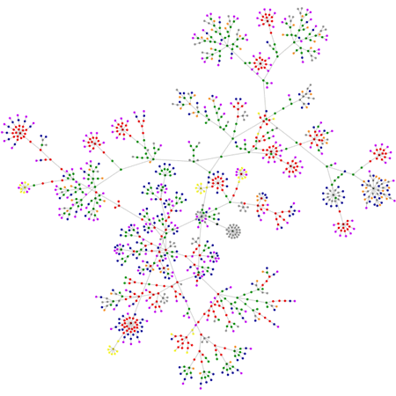
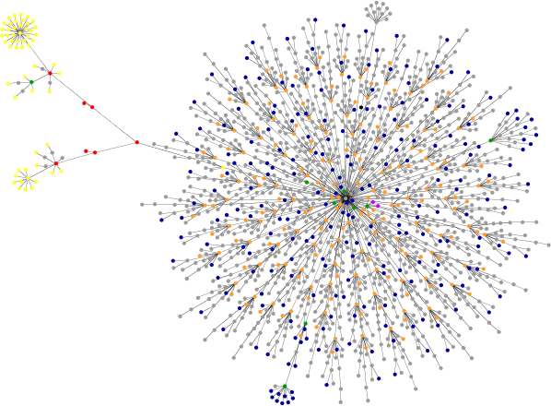
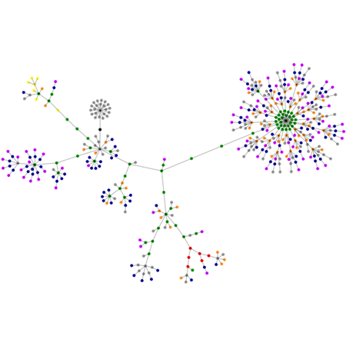
cnn.com
boingboing.net
wired.com
newyork.craigslist.org/aap/

Slide 6
Graphs & Trees: Overview
Definitions
Visualizing trees
node link
indented
enclosure (treemaps)

Slide 7

Graphs & Trees: Definitions
A graph G consists of
a collection of nodes (or vertices) V
a set of edges E, consisting of vertex pairs.
An edge e_{xy} = (x,y) connects two nodes x and y.
Example: V={1,2,3,4}, E={(1,2),(1,3),(2,3),(3,4),(4,1)}
1
2
2
1
3
1
3
3
2
4
4
4

Slide 8
Graphs & Trees: Definitions
5
0.3
2
2
1
0.1
3
2
A directed graph
An undirected graph
Weighted
Complete
Node degrees
root
0
parent
1
1
child
leaf
2
2
2
A cycle
An acyclic graph
A connected acyclic graph, a.k.a. a tree
A rooted tree
or hierarchy
Node depths

Slide 9
Graphs & Trees: Definitions
Graphs
Trees
models relations among data
nodes and edges
graphs with hierarchical structure
connected graph with n-1 edges
nodes as parents and children

Slide 10
Graphs & Trees: Definitions
Primary concern of graph drawing is the spatial layout of nodes and edges
Often (but not always) the goal is to effectively depict the graph structure
connectivity, path-following
network distance
clustering
ordering (e.g., hierarchy level)

Slide 11
Visualizing Trees
Rooted trees
Recursion makes it elegant and fast to draw trees
Approaches:
node link
indentation
enclosure (treemaps)

Slide 12
Visualizing Trees: Node-Link Diagrams
nodes are distributed in space, connected by straight or curved lines
typical approach is to use 2D space to break apart breadth and depth
often space is used to communicate hierarchical orientation

Slide 13
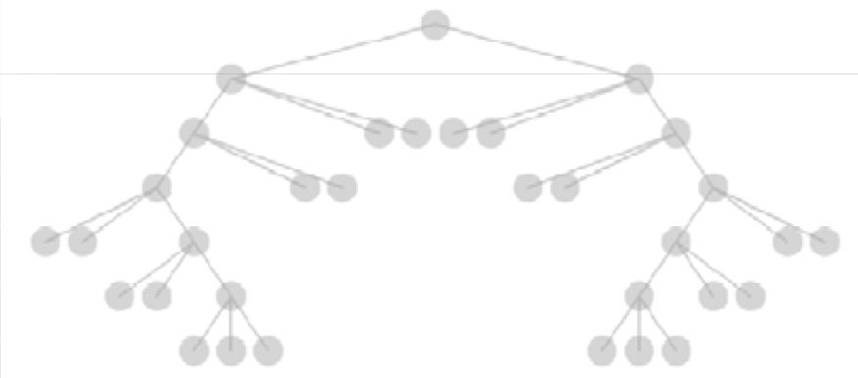
Visualizing Trees: Node-Link Diagrams
repeatedly divide space for subtrees by leaf count
breadth of tree along one dimension
depth along the other dimension
problem: exponential growth of breadth

Slide 14
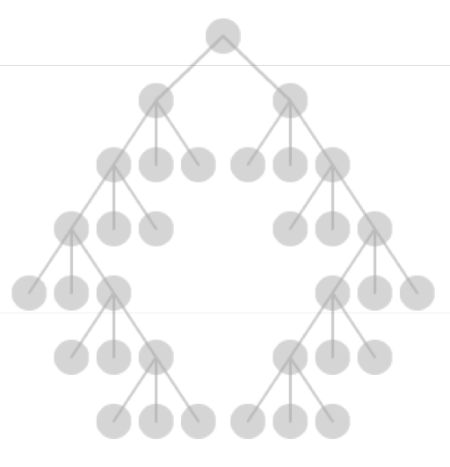
Visualizing Trees: Node-Link Diagrams: REINGOLD-TILFORD type layouts
goal
make smarter use of space
maximize density and symmetry
design concerns
clearly encode depth level
no edge crossings
isomorphic subtrees drawn identically
compact
approach
bottom up recursive approach
for each parent make sure every subtree is drawn
pack subtrees as closely as possible
center parent over subtrees
exam

Slide 15
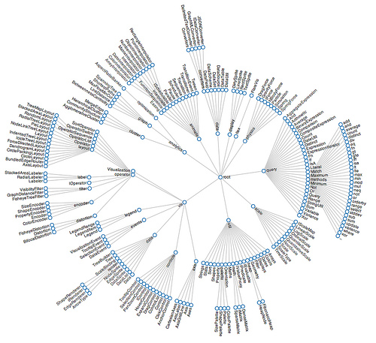
Visualizing Trees: Node-Link Diagrams: Radial Layout
node-link diagram in polar coordinates
radius encodes depth with root in center
angular sectors assigned to subtrees
Reingold-Tilford can be applied
http://seeingcomplexity.wordpress.com/2011/02/05/hierarchical-edge-bundles/

Slide 16
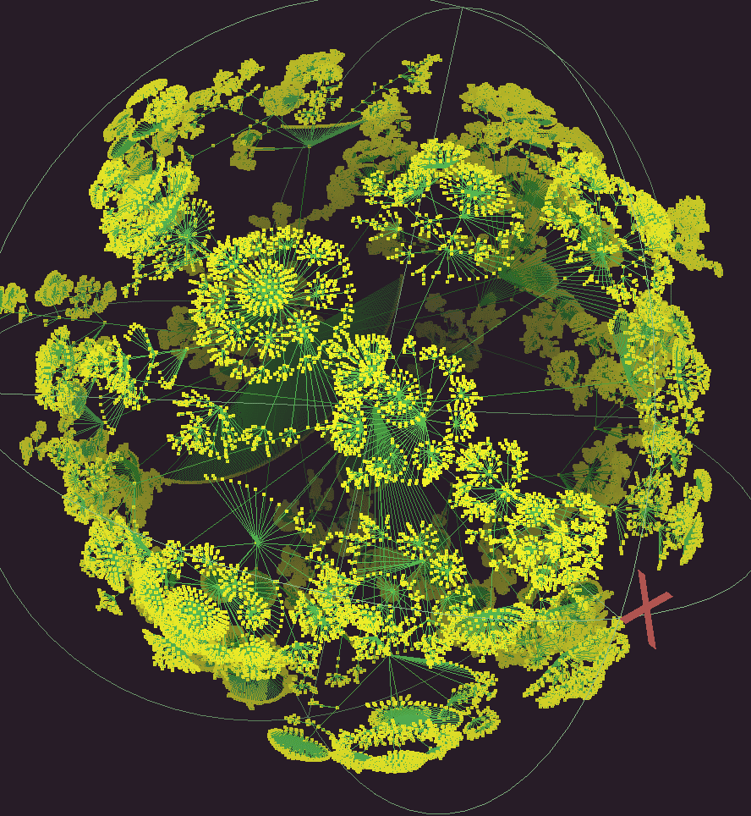
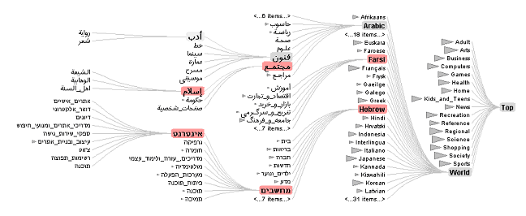
Visualizing Trees: Node-Link Diagrams: Problems
scale
tree breadth often grows exponentially
quickly run out of space!
solutions
hyperbolic layout
filtering
scrolling or panning
zooming
http://www.caida.org/tools/visualization/walrus/
http://vis.stanford.edu/papers/doitrees-revisited

Slide 17
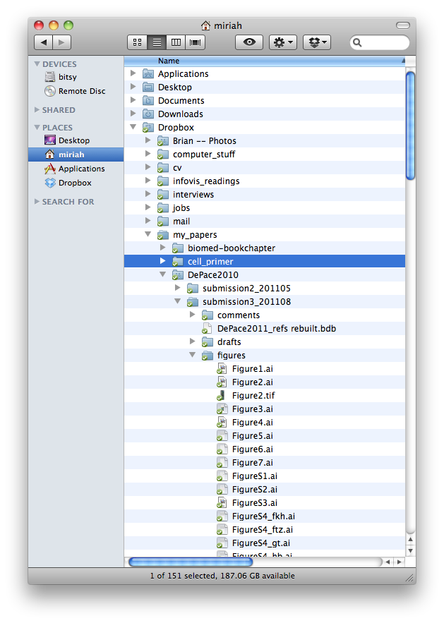
Visualizing Trees: Indentation
place all items along vertically spaced rows
indentation used to show parent/child relationships
commonly used as a component in an interface
resembles a sorted list
breadth and depth contend for space
often requires a great deal of scrolling

Slide 18
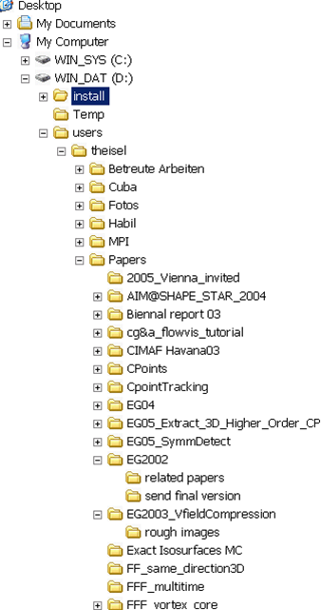

Visualizing Trees: Indentation
Trees are usually large and unbalanced
How to use the rectangular screen space optimally?

Slide 19
Visualizing Trees: Treemaps
encode structure using spatial enclosure
often referred to as treemaps
benefits
provides single view of entire tree
easier to spot small / large nodes
problems
difficult to accurately read depth
A
A
B
C
D
=
B
C
E
D
E

Slide 20
Visualizing Trees: Treemaps
recursively fill space based on a size metric for nodes
enclosure indicates hierarchy
additional measures can control aspect ratio of cells
Slice and Dice: alternate segmentation in horizontal and vertical direction
A:10
C
G
H
B
D
C:3
B:7
E
A
D:3
E:1
F:3
F
G:1
H:2

Slide 21
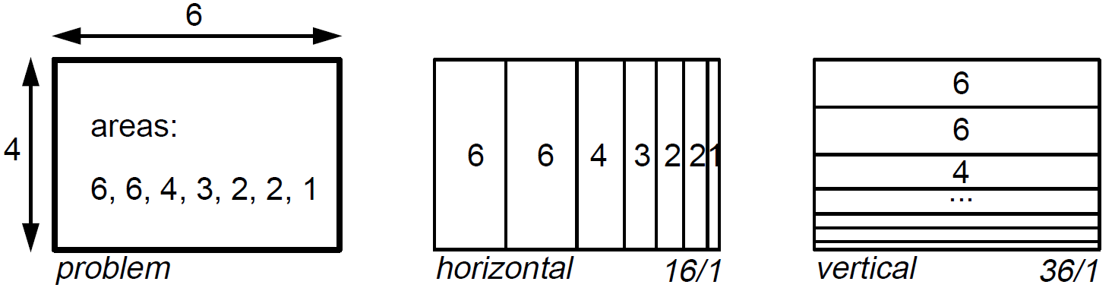
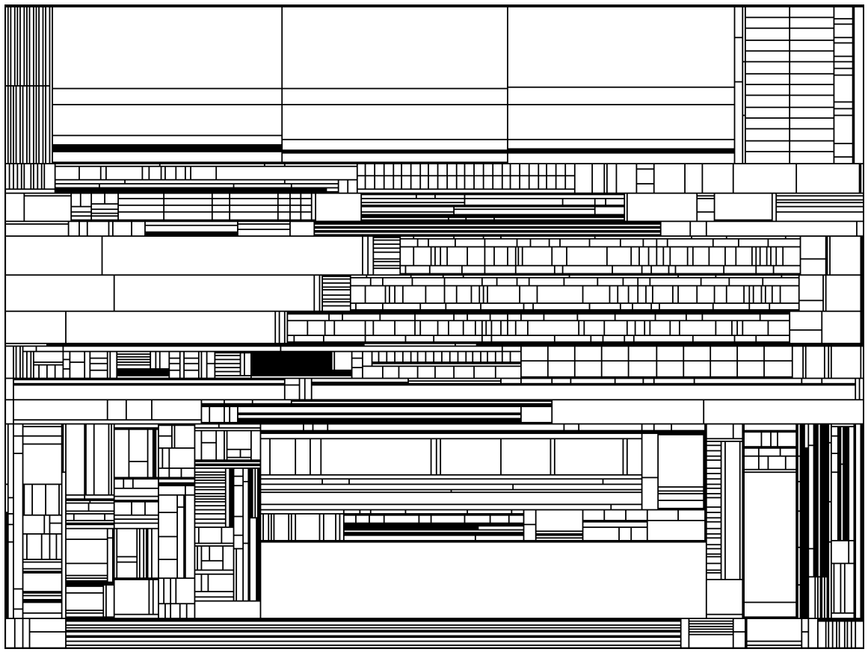
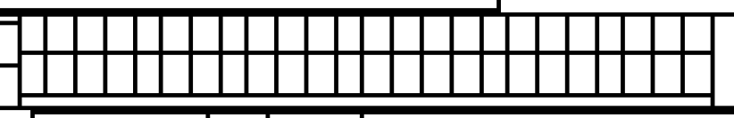
Visualizing Trees: Treemaps
Rectangles give distorted visualizations
File system
Bruls, Mark, Kees Huizing, and Jarke J. Van Wijk.
"Squarified treemaps." Data Visualization. 2000.

Slide 22
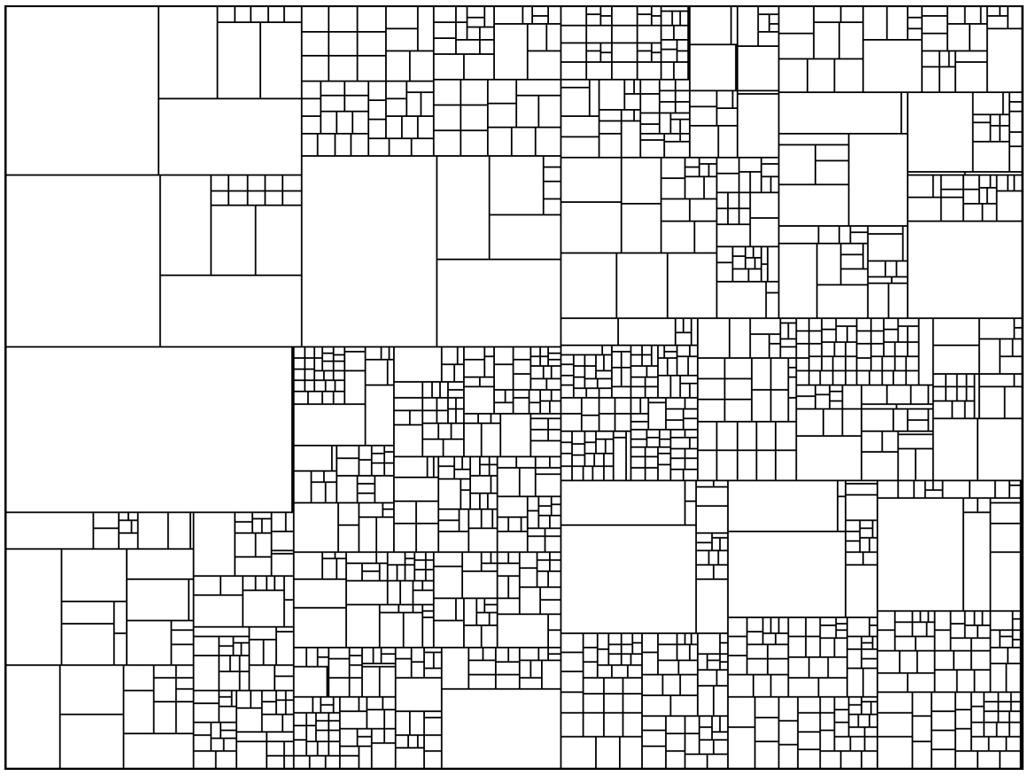
Visualizing Trees: Squarified Treemaps
Squarified treemaps: heuristic approach to favor squares over elongated rectangles
finding an optimal solution is NP-hard
File system
(same as before)
Bruls, Mark, Kees Huizing, and Jarke J. Van Wijk.
"Squarified treemaps." Data Visualization. 2000.

Slide 23
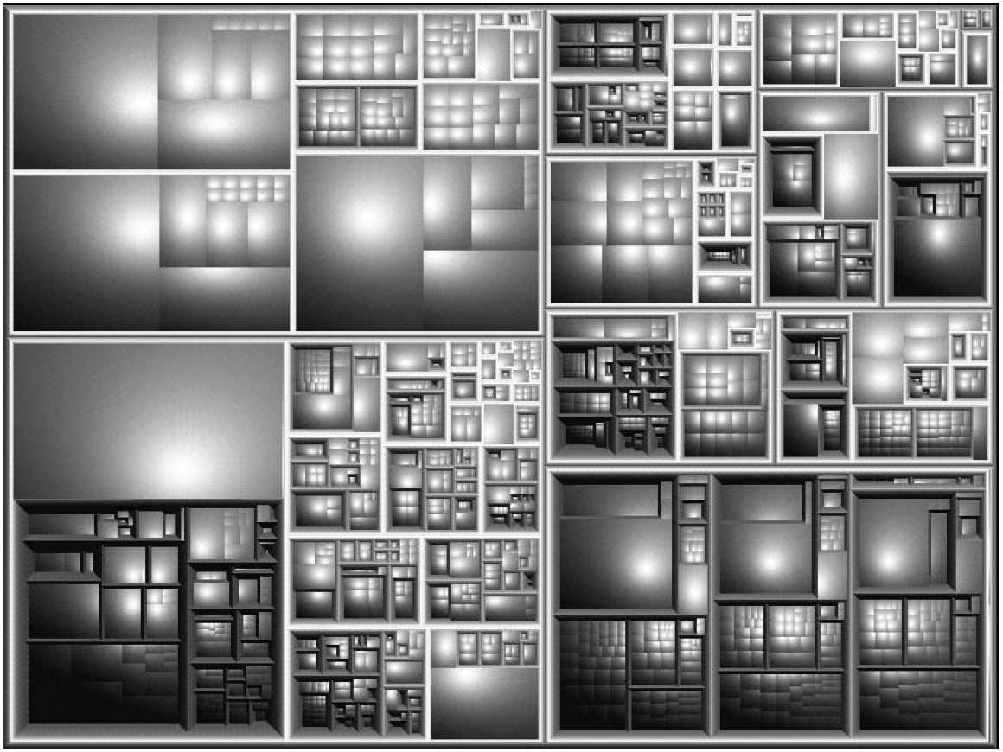
Visualizing Trees: Squarified Treemaps
Squarified treemaps: heuristic approach to favor squares over elongated rectangles
Improved perception using cushion shading and bevels
File system
(same as before)
Bruls, Mark, Kees Huizing, and Jarke J. Van Wijk.
"Squarified treemaps." Data Visualization. 2000.

Slide 24
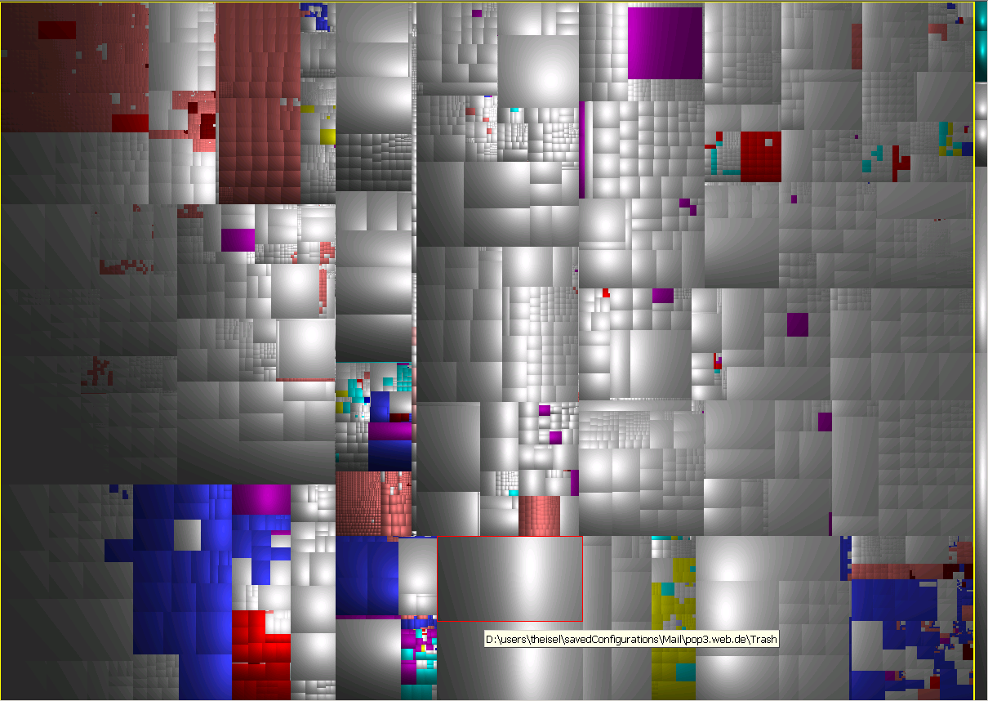
Visualizing Trees: Squarified Treemaps: Sequoiaview
http://w3.win.tue.nl/nl/onderzoek/onderzoek_informatica/visualization/sequoiaview/

Slide 25
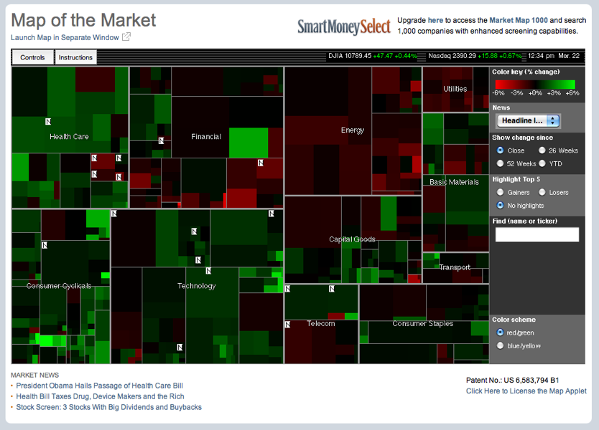
Visualizing Trees: Treemaps
http://www.smartmoney.com/map-of-the-market/
https://finviz.com/map.ashx

Slide 26
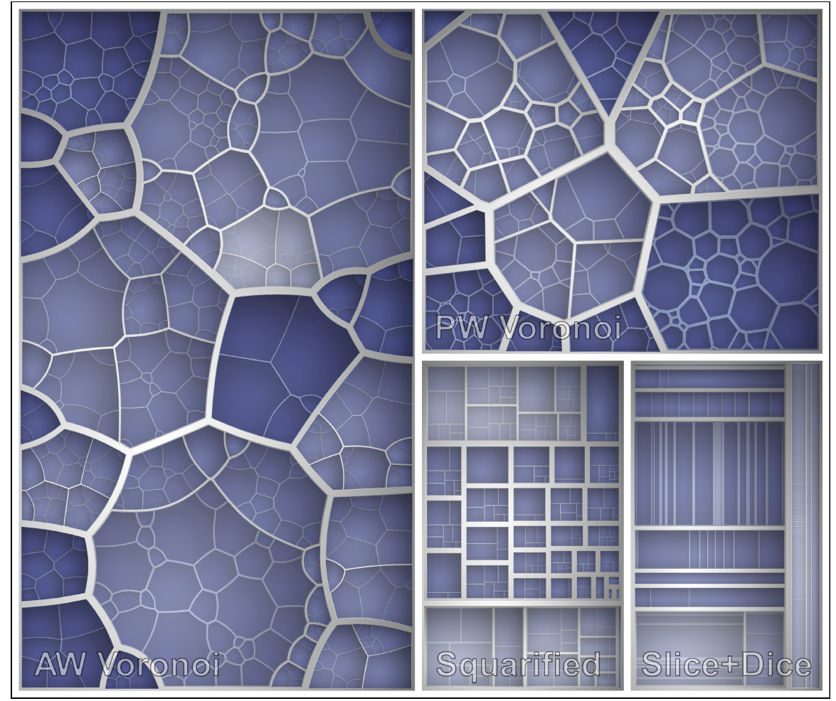
Visualizing Trees: Classic & Squarified & Voronoi Treemaps
Comparison of four Treemap layout algorithms: at first, the top hierarchy level was subdivided with the Squarified Treemap algorithm,
then for each of the four subareas according to its label a different layout algorithm was used (a brighter color indicates a lower hierarchy level).
Balzer & Deussen. "Voronoi Treemaps." InfoVis 2005.

